Slide 1
Statistical Inference
Parametric Approach

Slide 2
Contents
01
02
What is Statistical Inference?
Parameter, Estimator and Estimate
03
04
Testing of Hypothesis
One Sample t test
05
06
Independent Samples and Paired t tests
Analysis of Variance

Slide 3
What is Statistical Inference?
Statistical inference is the process of making probabilistic statements about unknown properties of a population based on sample data.
Rather than measuring every individual in a population, we collect a sample and use it to draw conclusions about the larger group.
Population Mean
Population Proportion
Population Variance
The average value across all individuals in the population
The percentage of the population with a specific characteristic
The spread or variability of values in the population
These unknown population properties are called parameters, and estimating them using sample data is the fundamental
goal of statistical inference.

Slide 4
Statistical Inference Framework
The inferential process involves using sample data to make educated guesses about population parameters. This requires careful attention to sampling methods, measurement precision, and probability theory.
01
02
Define the Population
Collect Sample Data
Clearly identify the group you want to study and the parameter of interest
Gather observations using appropriate random sampling
techniques
03
04
Calculate Sample Statistics
Make Inferences
Compute relevant values from your sample data
Use statistical methods to draw conclusions about population parameters

Slide 5
Parameter, Estimator, and Estimate
Understanding the distinction between these three concepts is crucial for proper statistical reasoning. Each plays a specific role in the inference process.
Parameter
Estimator
Estimate
An unknown property or characteristic of the population that we wish to learn about. Parameters are fixed values, though we don't know what they are.
A function or formula based on sample observations that is used to estimate the parameter. An estimator is a random variable with its own sampling distribution.
A particular numerical value obtained by substituting actual sample observations into an estimator formula. This is the concrete result from your specific sample.
Examples: Population mean (μ), population variance (σ²), population proportion (p)
Examples: Sample mean (x̄), sample variance (s²), sample proportion (p̂)
Example: If your sample mean is 45.3, then 45.3 is the estimate

Slide 6
Testing of Hypothesis
Hypothesis testing is a formal procedure for deciding whether a statement about a population parameter is supported by sample evidence. This approach allows researchers to test claims with controlled error rates.
Hypothesis
Null Hypothesis (H₀)
Alternative Hypothesis (H₁)
An assertion about the distribution or parameter of one or more random variables
A statement generally believed to be true until the researcher rejects it with sufficient evidence. This represents the status quo or default position.
The researcher's claim that contradicts the null hypothesis. This is what you're trying to find evidence for.
In simple terms, hypothesis testing helps us decide whether a statement about a population parameter is true or false based on sample data and probability theory.

Slide 7

Errors in Hypothesis Testing
When testing hypotheses, two types of errors can occur. Understanding these errors is essential for interpreting test
results correctly.
Reality ↓ Decision →
Reject H₀
Do Not Reject H₀
H₀ is True
Type I Error
Correct Decision
H₀ is False
Correct Decision
Type II Error
Type I Error (α)
Type II Error (β)
Power of the Test
Also called the level of significance. Typically set at 0.05 (5%). We reject H₀ if the p-value is less than α.
The probability of correctly rejecting a false null hypothesis. Higher power is better for detecting true effects.
The probability of failing to reject a false null hypothesis. More difficult to control than Type I error.

Slide 8
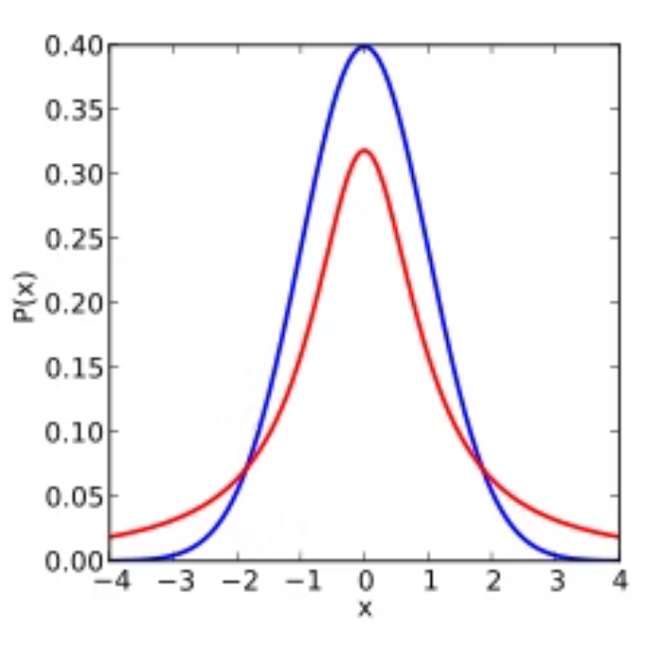
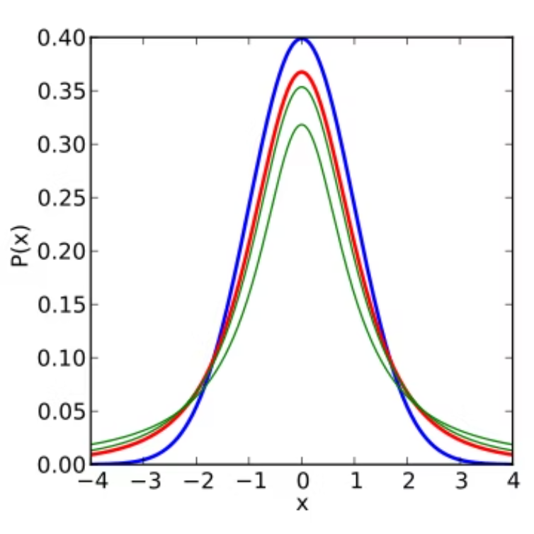
The t Distribution
The t distribution is a probability distribution used extensively in hypothesis testing, especially when sample sizes are small or population variance is unknown. It was discovered by William Sealy Gosset, who published under the pseudonym "Student."
Key Characteristics
Symmetric and bell-shaped, similar to the normal distribution
Lower peak and wider tails than the normal distribution
Shape depends on degrees of freedom (df)
As df increases, converges to standard normal distribution

Slide 9
One Sample t Test
The one sample t test is used to determine whether a sample comes from a population with a specific mean. This test is appropriate when you want to compare your sample mean to a hypothesized population value.
1
Purpose
2
Design
Tests hypotheses about a single population mean when population standard deviation is unknown
One group of subjects is measured, and the sample statistic is compared to a hypothesized population parameter value
3
Assumptions
4
Applications
Data is randomly sampled from a normally distributed population
Can be applied to various subjects: patients, customers, retail stores, transactions, or any measurable units

Slide 10
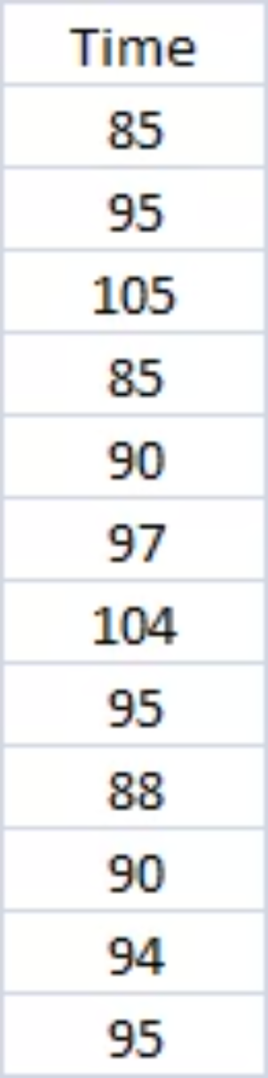
One Sample t Test: Example
A large company is concerned about the time employees take to complete their weekly MIS reports. The general manager claims that the average time exceeds 90 minutes. To test this claim, the company randomly selects 12 employees and records their completion times.
Hypotheses
Null Hypothesis (H₀): μ = 90 minutes
Alternative Hypothesis (H₁): μ > 90 minutes
Sample data: Times recorded for 12 employees

Slide 11

Test Statistic for One Sample t Test
The test statistic measures how many standard errors the sample mean is from the hypothesized population mean. A larger absolute value provides stronger evidence against the null hypothesis.
01
Calculate Sample Mean (x̄)
Find the average of all sample observations
02
Calculate Sample Standard Deviation (s)
Measure the variability in your sample data
03
Compute Test Statistic
Use the formula with n = sample size and μ₀ = hypothesized mean
04
Find p-value
Determine probability of observing your result if H₀ is true, using t-distribution with (n-1) degrees of freedom

Slide 12

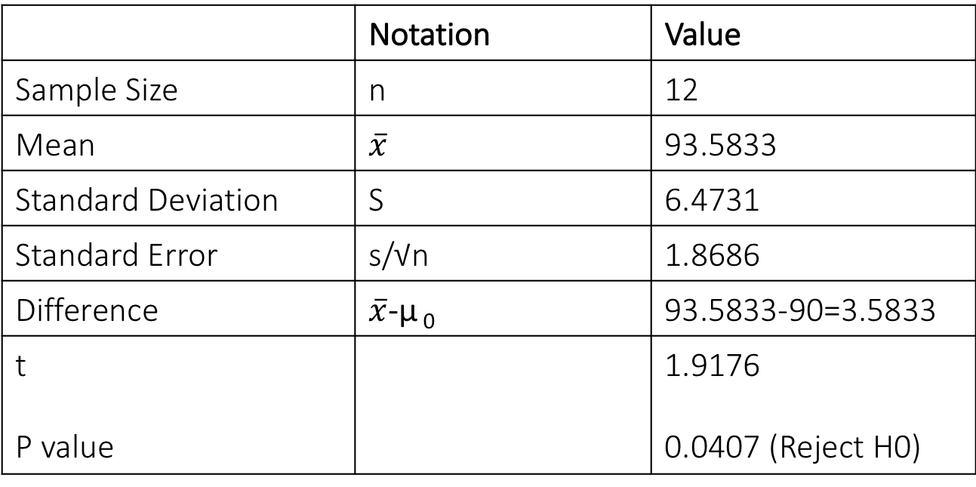
Drawing Inference: One Sample t Test Computation
 | Notation | Value
Sample Size | n | 12
Mean | $$\overline{x}$$ | 93.5833
Standard Deviation | S | 6.4731
Standard Error | s/√n | 1.8686
Difference | $\overline{x}$-μ ₀ | 93.5833-90=3.5833
t P value |  | 1.9176 0.0407 (Reject H0)

Slide 13

Drawing Inference: One Sample t Test
To make a decision, we compare the p-value to our predefined significance level (α). The p-value represents the probability of obtaining results as extreme as observed, assuming the null hypothesis is true.
Decision Rule
Conclusion
Compare p-value with level of significance α (typically 0.05 or 5%)
Reject H₀
The time taken to complete the MIS report is significantly more than 90 minutes.
If p-value < α: Reject H₀
If p-value ≥ α: Do not reject H₀
The evidence from our sample supports the general manager's claim at the 5% significance level.
Interpretation Note: "Significant" doesn't mean "important" in everyday language. It means we have sufficient statistical evidence to conclude the true mean exceeds 90 minutes, with our decision carrying no more than a 5% risk of Type I error.

Slide 14
Independent Samples t Test
The independent samples t test compares the means of two separate, unrelated groups on the same continuous variable. This is one of the most commonly used statistical tests in research and data analysis.
Purpose
Key Requirement
Common Applications
Determines whether two population means are significantly different from each other
The two groups must be independent — observations in one group should not influence observations in the other group
Treatment vs. control groups, male vs. female, different age groups, different geographic regions
Hypotheses
H₀: μ₁ = μ₂ (The two population means are equal)
H₁: μ₁ ≠ μ₂ (The two population means are not equal)
This is typically a two-tailed test unless there's a specific directional hypothesis.

Slide 15
Independent Samples t Test: Example
The company wants to assess whether employee experience level affects the time required to complete MIS reports. They compare two groups of employees based on their years of experience.
Group I
Group II
Experience: 0-1 years
Experience: 1-2 years
New employees with limited experience completing MIS reports
More experienced employees familiar with the reporting process
Research Question
Does experience level significantly affect the time required to complete MIS reports?
Hypotheses
Null Hypothesis (H₀): Average completion time is equal for both groups (μ₁ = μ₂)
Alternative Hypothesis (H₁): Average completion time differs between groups (μ₁ ≠ μ₂)

Slide 16
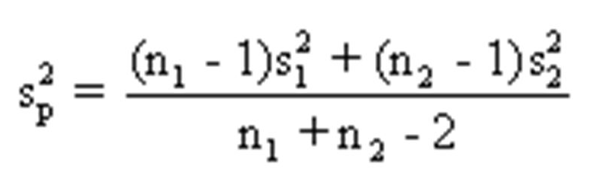

Test Statistic for Independent Samples
The test statistic for independent samples t test compares the difference between sample means relative to the
variability within the groups.
Where x̄₁ and x̄₂ are sample means, s₁² and s₂² are sample variances, and n₁ and n₂ are sample sizes for groups 1 and 2 respectively.
Pooled Variance Assumption: This formula assumes equal population variances. If this assumption is violated, a modified version (Welch's t test) should be used, which adjusts the degrees of freedom calculation.

Slide 17



Drawing Inference: Independent Samples t test
After calculating the test statistic and obtaining the p-value, we compare it to our significance level to make a decision about the null hypothesis.
Calculate Test Statistic
Determine p-value
Make Decision
Compute t-value using the formula with sample data from both groups
Find probability using t-distribution with (n₁ + n₂ - 2) degrees of freedom
Compare p-value to α = 0.05 and draw conclusion
Based on the comparison of p-value with the significance level, we either reject or fail to reject the null hypothesis. The conclusion should be stated in the context of the research question, explaining what the result means for employee experience and MIS report completion times.

Slide 18
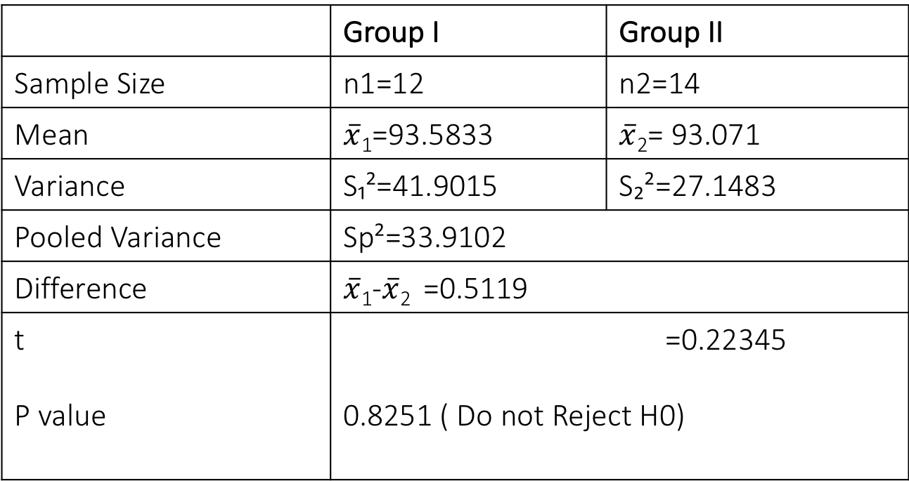
Drawing Inference: Independent Samples t test Computation
 | Group I | Group II
Sample Size | n1=12 | n2=14
Mean | $$\overline{x}\text{1}\text{=}\text{93.5833}$$ | $\overline{x}$₂= 93.071
Variance | S₁²=41.9015 | S₂²=27.1483
Pooled Variance | Sp²=33.9102
Difference | $\overline{x}$₁-$\overline{x}$₂ =0.5119
t P value | =0.22345 0.8251 ( Do not Reject H0)

Slide 19
Paired Sample t Test
The paired sample t test (also called dependent samples t test) is used when observations are naturally paired or matched. This design is more powerful than independent samples because it controls for individual differences.
1
2
3
When to Use
Common Applications
Key Advantage
Two measurements on the same subjects (repeated measures) or measurements on matched pairs of subjects
Before-and-after studies, pre-test and post-test designs, matched case-control studies
Controls for individual variability by focusing on within-subject differences rather than between-subject differences
This test is particularly useful for evaluating the effectiveness of an intervention or treatment. Rather than comparing two independent groups, we measure the same subjects twice and test whether the average change is significantly different from zero.

Slide 20



Paired Sample t Test: Example
The company organized a training program designed to improve employee efficiency in completing MIS reports. To evaluate the program's effectiveness, they measured completion times for 15 employees both before and after the training.
Before Training
Training Program
After Training
Baseline completion times recorded for 15 employees
Employees participate in efficiency improvement training
Same 15 employees measured again
Hypotheses
Null Hypothesis (H₀): μ_before = μ_after
Average completion time is the same before and after training (training has no effect)
Alternative Hypothesis (H₁): μ_after < μ_before
Average completion time after training is less than before (training is effective in reducing time)
This is a one-tailed test because we have a directional hypothesis that training should reduce completion time.

Slide 21

Test Statistic for Paired Sample t Test
For paired samples, we calculate the difference for each pair, then test whether the mean difference is significantly different from zero.
01
Calculate Differences
For each pair, compute d = (Before - After). This gives you n difference scores.
02
Find Mean Difference
Calculate d̄, the average of all difference scores
03
Calculate Standard Deviation
Find Sd, the standard deviation of the difference scores
04
Compute Test Statistic
Use the formula where n is the number of pairs, with df = n - 1

Slide 22
Drawing Inference: Paired Sample t Test Computation
 | Notation | Value
Sample Size | n | 12
Mean difference (before-after) |  | 8.3333
Standard Deviation |  | 3.9219
t P value |  | 8.2295 <0.05 (Reject H0)

Slide 23
Drawing Inference: Paired Sample t Test
After calculating the test statistic for the paired samples, we determine the p-value and make our decision about the training program's effectiveness.
Statistical Decision
Practical Interpretation
Effect Size
Compare the calculated p-value with α = 0.05
We reject H₀, we conclude that the training program significantly reduced the time required to complete MIS reports.
Beyond statistical significance, examine the magnitude of the mean difference to assess practical importance.
If p-value < 0.05: Reject H₀
If p-value ≥ 0.05: Do not reject H₀
A statistically significant result with a small difference may not be practically meaningful.

Slide 24

Analysis of Variance (ANOVA)
Analysis of Variance (ANOVA) is a statistical method for comparing means of three or more groups simultaneously. Developed by statistician and evolutionary biologist Ronald Fisher, this technique revolutionized experimental design and data analysis.
Why ANOVA Instead of Multiple t Tests?
When comparing multiple groups, conducting multiple t tests increases the risk of Type I error (false positives). ANOVA provides a single test that controls the overall error rate while testing all group comparisons simultaneously.
Core Concept
Despite its name, ANOVA analyzes variance to test differences in means. The method partitions total variance into components: variance between groups and variance within groups. If between-group variance is large relative to within-group variance, we conclude the groups have different means.

Slide 25
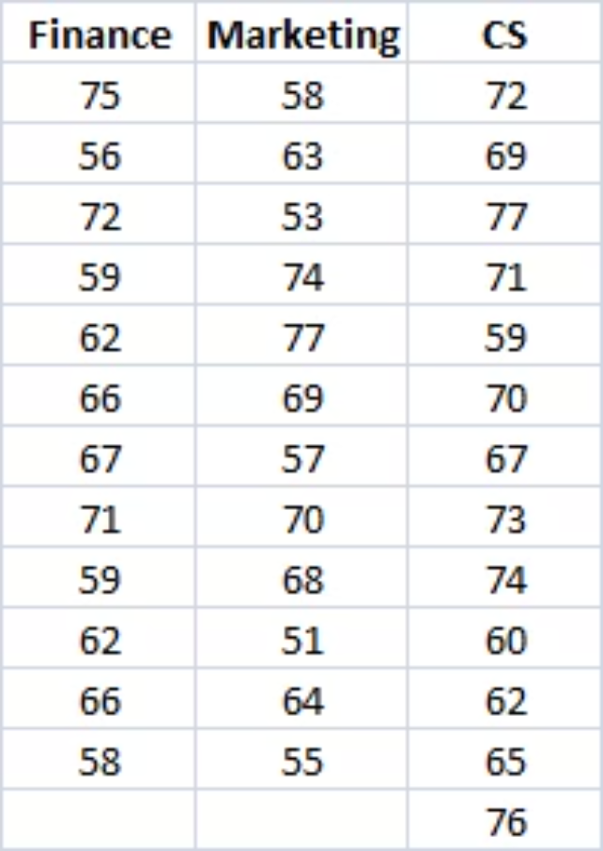

One-Way ANOVA: Example
A large company wants to assess whether employee satisfaction differs across three departments: Finance, Marketing, and Client-Servicing. They measure the Satisfaction Index for 37 employees across these departments.
Sample Composition:
Finance: n₁ = 12 employees
Marketing: n₂ = 12 employees
Client-Servicing: n₃ = 13 employees
Total: N = 37 employees
Hypotheses
Null Hypothesis (H₀): μ₁ = μ₂ = μ₃
All three departments have the same average satisfaction index
Alternative Hypothesis (H₁): Not all means are equal
At least one department differs in average satisfaction from the others
Note: The alternative hypothesis does NOT specify which groups differ. If ANOVA is significant, post-hoc tests are
needed to identify specific differences.

Slide 26
ANOVA Results and Conclusion
The ANOVA table partitions the total variation in satisfaction scores into variation between departments and variation
within departments.
Source
df
Sum of Squares
Mean Square
F-value
Between Groups
2
220.06
110.03
2.308
Within Groups
34
1,620.86
47.67
Total
36
1,840.92
p-value = 0.1148
Decision
Conclusion
Do not reject H₀
There is insufficient evidence to conclude that average satisfaction index differs among the three departments (Finance, Marketing, and Client-Servicing).
Since p-value (0.1148) > α (0.05), we fail to reject the null
hypothesis
The observed differences in sample means could reasonably be attributed to random sampling variation rather than true population differences.

Slide 27



Key Takeaways
One Sample t Test
Independent Samples t Test
To test whether the population mean is equal to the specified mean
To test the equality of two population means
Paired t Test
One Way Anova
To test whether the mean difference is zero in a before-after design
To test the equality of K population means

